Slide 1
TO ASK FOR HELP

Slide 2
WOULD YOU RATHER
Have tacos for lunch
Have pizza for lunch

Slide 3
OBJECTIVES
Discuss the importance of choosing to ask for help
Learn best practices for asking for help
Reflect on opportunities you may have to ask for help

Slide 4
USE ALL YOUR STRENGTH
Notes:
https://youtu.be/_ucrCVj0waI

Slide 5
DISCUSSION
Why do you think the speaker continued to say, “Use all your strength"?

Slide 6
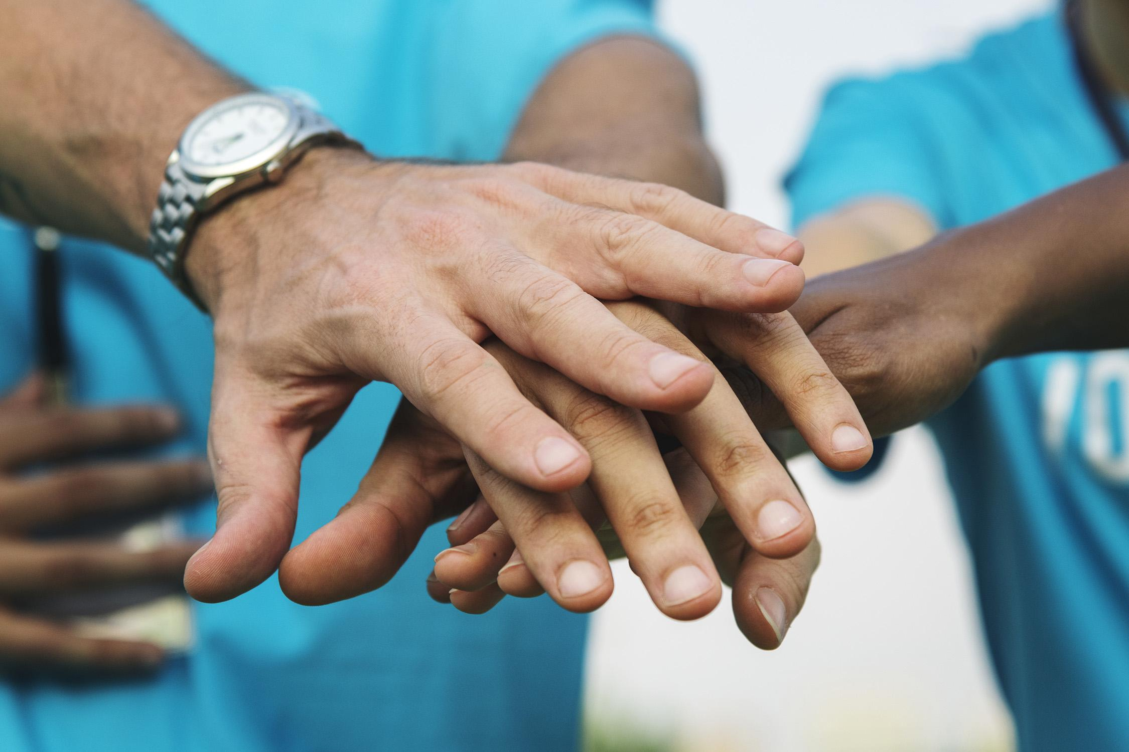
GIVING VS. GETTING HELP
People are hardwired to be helpful.
Helping others can boost your:
Mood
Self-Esteem
Sense of Belonging

Slide 7
GIVING VS. GETTING HELP
Asking for help is not human nature.
People are hardwired to want to do things on their own; to be independent minded.
There are many reasons why asking for help makes people feel uneasy:
They get embarrassed
They don't want to be judged
The other person might say “no"

Slide 8
DISCUSSION
Is it easier for you to give help or to ask for help?

Slide 9
NORMALIZING ASKING FOR HELP
Notes:
https://www.youtube.com/watch?v=yXz9aoHdnnk

Slide 10
BEST WAYS TO ASK FOR HELP
Be
Specific
Be
Direct
In Person
(34% more likely to get a "Yes")
Be
Positive
Be Understanding

Slide 11
MAKE A CHOICE
At least once a day you probably make a choice to ask for help or to do something on your own.
Everyone needs help from time to time.
Try to get in the habit of asking for help.
The more often you do, the easier it will become!

Slide 12
DISCUSSION
What is something you can ask for help with today?

Slide 13
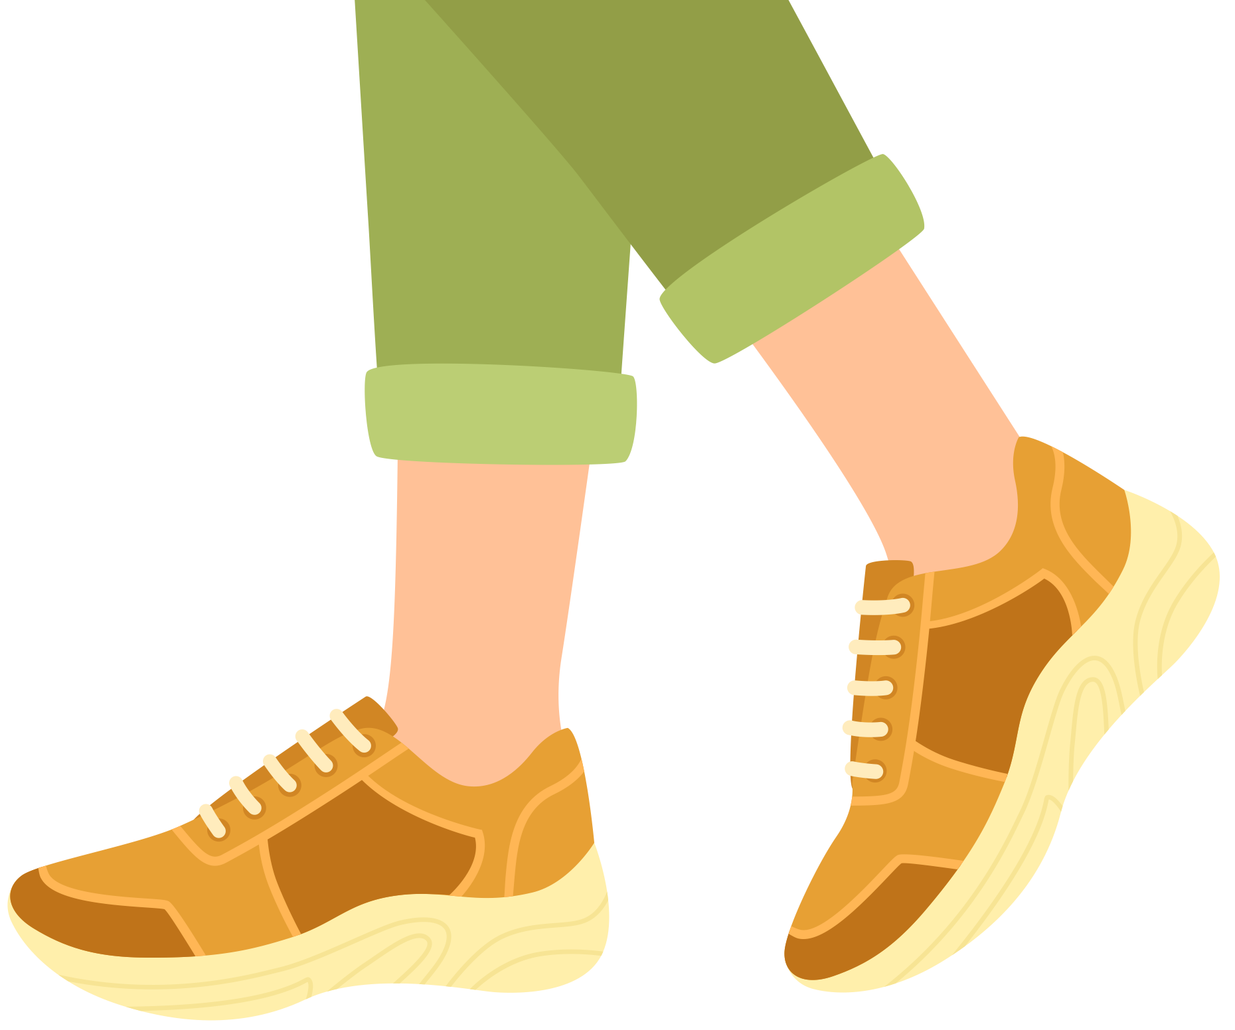
CHECK OUT
What will you do for yourself today?
Sleep and
rest well
Write in your journal
Walk around your neighborhood
Stay hydrated
Listen to your favorite songs
Workout

Slide 14
Committed to fostering a safe and respectful District, school and community culture where the seeds of peace and justice are sown so that all students and staff can lead safe, purposeful and academically fruitful lives.
Connect with us at bit.ly/LAUSD-HRDE

